Slide 1
Interrogating public datasets and paths to results on COVID-19 in East Africa
Mike Mwanga, Eva Akurut, Isaac E Omara, Edward Lukyamuzi, Levis Katwiire, Paul Talent, Ibra Lujumba

Slide 2
Coronavirus Virus Disease 2019 (COVID-19)
COVID-19 is caused by severe acute respiratory syndrome coronavirus 2 (SARS-CoV-2)
First Identified in December 2019 in Wuhan China and declared pandemic on 30 January 2020
Mode of Transmission : droplets, contact routes
Symptoms : Fever, dry cough, sore throat, breathing problems, headaches, lack of smell
Notes:
The disease is COVID-19, caused by a virus called SARS-CoV-2 - Identified in China, declared pandemic by WHO in January 2020
-Three known modes of transmission; droplet transmission - which occurs when respiratory droplets produced by an infected person (through coughing or sneezing) gets ingested or inhaled by individuals in close proximity. Contact transmission occurs when one touches contaminated surfaces or objects and subsequently touches nose/mouth/eyes. Aerosol transmission occurs when respiratory droplets mix into the air, forming aerosols and cause infection (https://microbenotes.com/transmission-pathogenesis-replication-of-sars-cov-2/)
-Symptoms include...among others

Slide 3
Cases overview on 6th August 2020
Global
Africa
East Africa
Confirmed
19,026,375
Confirmed
998,991
Confirmed
25,605
Deaths
712,179
(3.7%)
Deaths
21,700
(2.1%)
Deaths
417
(1.6%)
Recoveries
12,207,180
(64%)
Recoveries
678,781
(67.9%)
Recoveries
11,215
(43.8%)
https://www.worldometers.info/coronavirus/
Notes:
Globally, as of 6th of August global cases had reached 19 million COVID cases, with

Slide 4
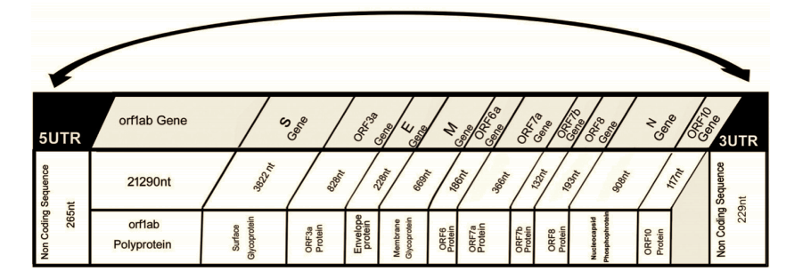
Genome structure of SARS-CoV-2
Enveloped, ssRNA(+), Non-segmented genome (~30kb)
Viral genome codes for; 16-Non-structural proteins, 4 structural proteins, 9 accessory factors
https://www.ncbi.nlm.nih.gov/pmc/articles/PMC7161481/
Notes:
SARS-CoV-2 is an enveloped, single-stranded, positive-sense RNA virus with a non-segmented genome ~30 kb in size.
The viral genome codes for 16 non-structural proteins (Nsps) required for virus replication and pathogenesis, four structural proteins, including envelope (E), membrane (M), nucleocapsid (N), and spike (S) glycoprotein important for virus subtyping and response to vaccines.

Slide 5
Problem Statement
COVID-19 has affected all our lives and the pandemic is still running its course in the world. This has spurred an unprecedented scientific effort to understand the pathogen, SARS-CoV-2, the means of its spread and control
Large quantities of epidemiological and bioinformatics data have been generated and are publicly available

Slide 6
Objectives
General objective:
To undertake epidemiologic and bioinformatics analysis of COVID-19 data from East Africa
Specific objectives:
Epidemiologic analysis
To analyze infection statistics of COVID-19 in E. Africa using SEIR model
Obtain the basic reproduction ratio, R₀
Assess the role of non-pharmaceutical interventions (NPIs) in curbing the spread of COVID-19

Slide 7
2. Specific objectives - Bioinformatics analysis
Investigate genetic diversity of SARS-CoV-2 detected in E. Africa
Estimate evolutionary rate of SARS-CoV-2 and time of most common recent ancestor (TMRCA)
Compare sequences from East Africa with global sequences and infer the source of infection and the contribution of international and local infections through time of the pandemic

Slide 8
2. Specific objectives - Bioinformatics analysis
Analysis of variable and conserved sequences with the aim of finding a marker gene
Depending on the viral diversity within East Africa, is the use of available primers sensitive enough to detect infections?
Phylogeographic analyses of sequences within respective East African countries (is viral diversity correlated with geographic origin?)

Slide 9
Epidemiological analysis pipeline
Download raw data in CSV format from the WHO website
Solve differential equations using deSolve package
LIterature review
(parameters)
Filter out data for relevant countries using dplyr package
Fit model to data, obtain best-fit parameters
Preprocessing
Estimate parameter uncertainties using MCMC

Slide 10
Phylogenetics and phylogeographic analysis
Data Collection (GISAID Initiative, NCBI Nucleotide)
Multiple Sequence Alignment (MAFFT)
Maximum likelihood and Bayesian inference
(PhyML, FigTree, BEAST)
Literature review
(parameters)
Results
Notes:
Complete genomes from E.A will be retrieved from GISAID/NCBI nucleotide database. Random selection and retrieval of genome sequences from Middle East (Dubai), Asia (China), Europe (UK) and America (U.S) to represent overseas cases

Slide 11
Significance of our work
Generate information on the spread of COVID-19 in E.africa so as to design appropriate public health interventions
Insights on the genetic diversity inform testing procedures and vaccine efforts
Contribute to the knowledge base on COVID-19

Slide 12
Expected challenges
Insufficient data
Steep learning curve
Deadline
Resources (Mak labs, and Pwani)

